Slide 1
Sepsis
B. Taylor Thompson M.D.
Professor of Medicine,
Harvard Medical School

Slide 2
Outline
Sepsis Defined
New mechanistic insights
Sepsis subphenotypes

Slide 3
Sepsis
Sepsis is a term derived from the ancient Greek for rotten flesh and putrefaction.
1680s: Leeuwenhoek’s observed “animalcules” (bacteria)
200 years passed before bacteria were linked to infection (Koch, Pasteur, Semmelweis, and Lister).
1914: Schottmueller concluded that pathogenic germs in the bloodstream caused systemic symptoms and signs
1975: Systemic release of cytokines and activation of white blood cells and coagulation even in the absence of whole bacteria caused sepsis

Slide 4
Sepsis
Third most common cause of death world wide
Over 1 million cases of sepsis in the US with a mortality of 10 - 40%
Major sites of infection leading to sepsis:
Lung
Abdomen
Urinary tract
Skin and Soft Tissues
Central nervous system
(30% unknown source)

Slide 5
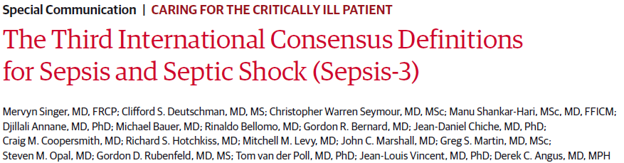
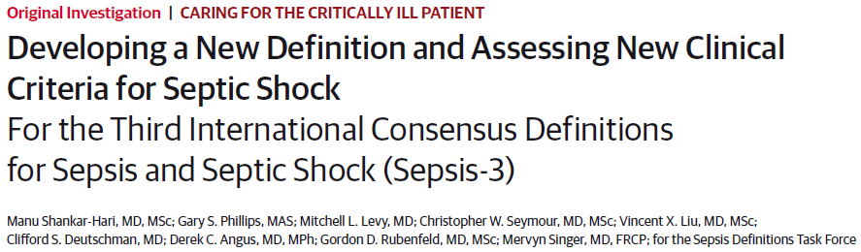
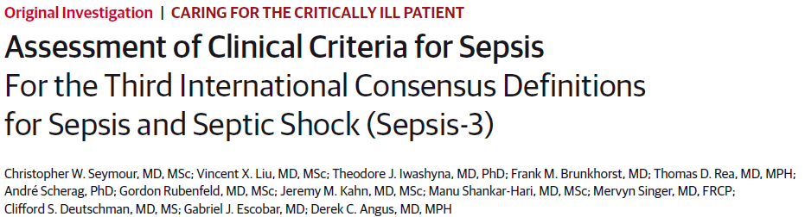
Literature review, Delphi,
3 Cohorts ~3.2 million pts
Assess predictive validity
in ~1.3 million patients

Slide 6
SEPSIS-3, ICU Definition:
Sepsis is defined as life-threatening organ dysfunction caused by a dysregulated host response to infection
Organ dysfunction is measured by abnormal laboratory values, blood pressure, and mental status. The Sequential Organ Failure Assessment (SOFA) score is used to grade severity of organ dysfunction on a 0-4 point scale for each organ system
A 2 point change in total SOFA from infection is associated with a 10% mortality risk in a general hospital population.
*
Singer JAMA 2016

Slide 7
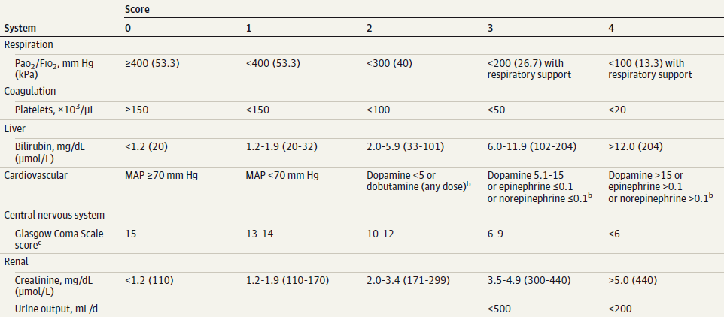
SOFA Score

Slide 9
SEPSIS-3: Septic Shock
Septic shock is a subset of sepsis in which underlying circulatory and cellular/metabolic abnormalities are profound enough to substantially increase mortality
Septic Shock Definition:
Persisting hypotension requiring vasopressors to
maintain a mean arterial pressure of > 65 mmHg and
having a serum lactate level > 2mmol/L despite “adequate” (NOS) volume resuscitation.
Hospital mortality > 40%.
Singer JAMA 2016

Slide 10
Outline
Sepsis Defined
New mechanistic insights
Sepsis subphenotypes

Slide 11
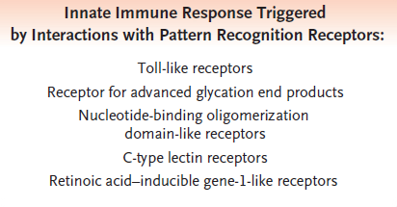
Klempner NEJM 2010

Slide 12
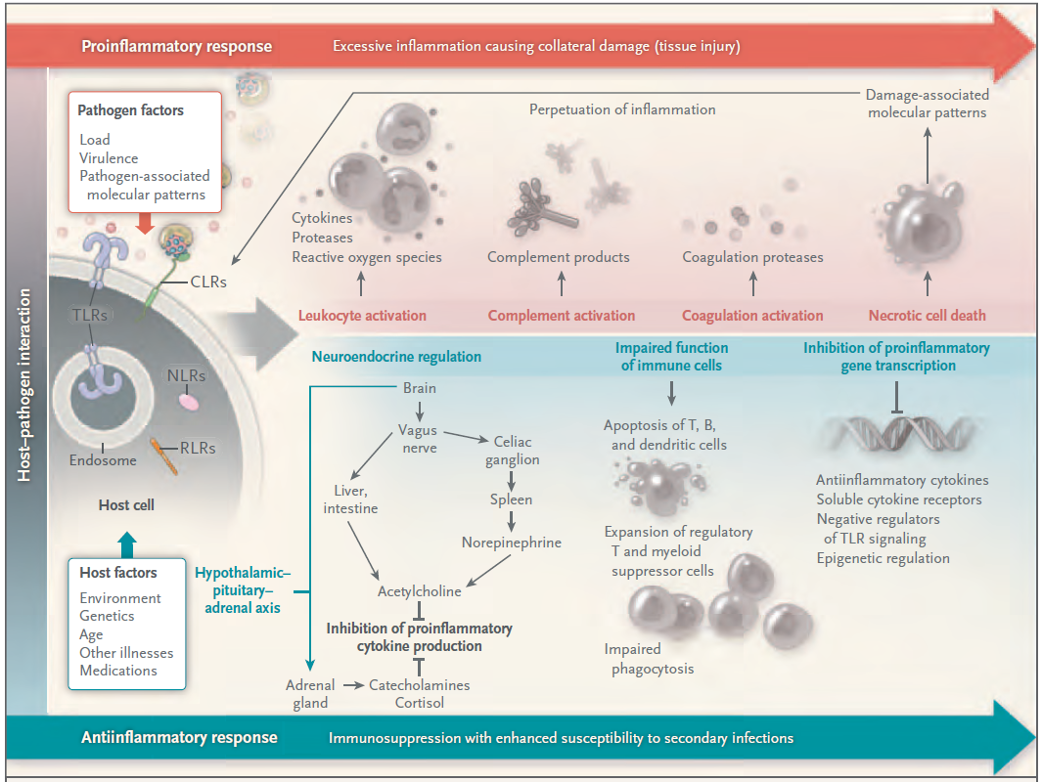

Slide 13
Higher Circulating Mitochondrial DNA
in Fatal Sepsis
Brigham and Women’s
MGH
Nakihira PLOS Med 2013

Slide 14
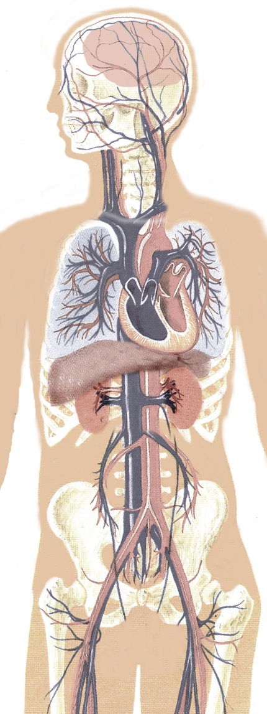
Sepsis and Organ Dysfuntion
Heart Failure
Heart weakens and dilates due to circulating factors
Markers of heart muscle death circulate in the blood but the heart muscles largely appear to be normal histologically
Coma or Encephalopathy
Altered consciousness, confusion, psychosis
EEG shows diffuse slowing
Brain structurally normal
ARDS
Inflammation, vascular leak, intravascular coagulation
Kidney Failure
Urine flow is reduced and medicines to increase flow (diuretics) no longer work
Epithelial cells are present in the urine suggesting injury though renal histology is largely normal
Vast majority with failed kidneys requiring dialysis recover
Shock
Vascular smooth muscle cells become hyper-polarized due to changes in potassium conductance
Increased endogenous vasodilators
Notes:
This slide is a graphic representation to clues to organ dysfunction when evaluating a septic patient.

Slide 15
Sepsis Survivor
Normal
Sepsis Non-Survivor
Kumar Virulence 2014

Slide 16
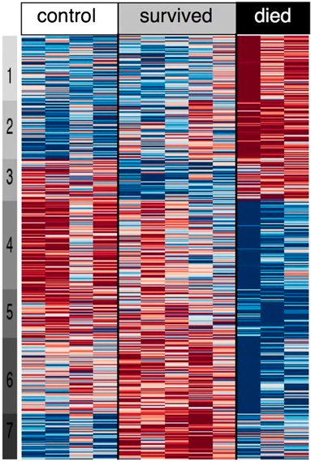
2010

Slide 18
Antibiotics and Sepsis; necessary but not sufficient for survival
Infection
Appropriate antibiotics decrease evolution to severe sepsis by ~50%⁺
Immune/coagulation Activation
Sepsis
Appropriate antibiotics reduce mortality by
10-15% ; mortality remains 10-40%*
Death
⁺ Kreger AJM 1980; Simon Crit Care Clin 2000
* Pittet AJRCCM 1996; Opal CCM 1997

Slide 19
Immune Modulation for
Severe Sepsis has Largely Failed
No Benefit or Harm in >100 studies
Anti-LPS (Polyclonal Ab, HA-1A, E5)
Anti-TNF or IL-1 strategies
IVIG, Interferon gamma, GCSF
Growth hormone
Soluble PLA₂, elastase, and PAF Inhibitors
Heparin, antithrombin
Ibuprofen
APC for lower risk severe sepsis
Tissue factor pathway inhibitor (Opal ESICEM 2009)
Phospholipid emulsion (Dellinger CCM 2009)
TLR-4 antagonist (Tidswell CCM 2010, Opal, 2012)
APC for persistent septic shock (Ranieri & Thompson, 2012)
Notes:
19

Slide 20
For sepsis, the drugs don’t work
“A deeper understanding of the processes leading to sepsis is necessary before we can design an effective suite of interventions.”
The Lancet Infectious Disease; Feb 2012

Slide 21
The response to infection differs between individuals. Up to 6 different sepsis responses (or sepsis subtypes) to infection have been reported

Slide 23
Unsupervised consensus clustering and machine learning of the
blood transcriptome in patients with sepsis from severe CAP

Slide 24
Retrospective analysis of four large datasets (n=16-43k) and 4 RCTs (n=)4737
Machine learning and unsupervised clustering methods using clinical data
Four subgroups of sepsis = best fit Mortality
α (33%): most common, lowest vasopressors 5%
β (27%): older, more chronic illness and renal dysfunction 13%
γ (27%): more inflammation and pulmonary dysfunction 24%
δ (13%: more liver dysfunction and septic shock 40%

Slide 25
Results of 10,000 simulated trials with different subtype distributions (more α or δ)

Slide 26
Patients with the immunocompetent Sepsis Response Type 2 subtype who were treated with corticosteroids had poorer survival than those given placebo
OR for death = 7.9 (1.6-39.9); interaction p = 0.02

Slide 27
Sepsis Subtypes
As for Type 1 and Type 2 diabetics, we will have a different understanding of and will be making different treatment decisions for patients with “Type 1 sepsis, Type 2 sepsis, etc. etc. etc.”

Slide 28
Summary and Conclusion
Sepsis is a common and potentially lethal response to infection
The release if molecules from the initial tissue injury amplify the response
Dysregulated innate immune response has both hyper and hypo-inflammatory responses that appear to differing degrees in different subtypes
A Systems Biology approach to understanding sepsis and multiple organ failure will need to embrace this heterogeneity and perhaps explain it

Slide 29
Summary and Conclusion
Future treatments will likely be guided by a better understanding of the subtypes of immune and coagulation system dysregulation and seek to restore homeostasis (and perhaps cellular energetics)

Slide 30
Thank you
thompson.taylor@mgh.harvard.edu

Slide 31
Extra Slides

Slide 33
Calfee and Matthay Nature 2010

Slide 34
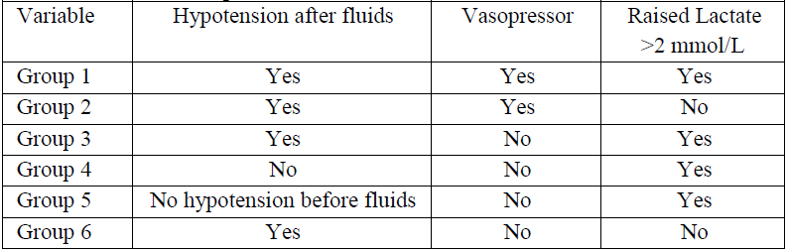
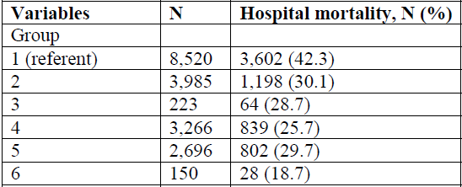
SEPSIS-3 Definition of Shock Why Vasopressors and Lactate > 2?
Shankar-Hari JAMA eSuppl 2016

Slide 35
942,000 in-patients
(57,242)
(41,618)

